Slide 1

HPML Group 05/11/2024
Deep Learning
Introduction Series
Simone van Bruggen
Lars Veefkind

Slide 2
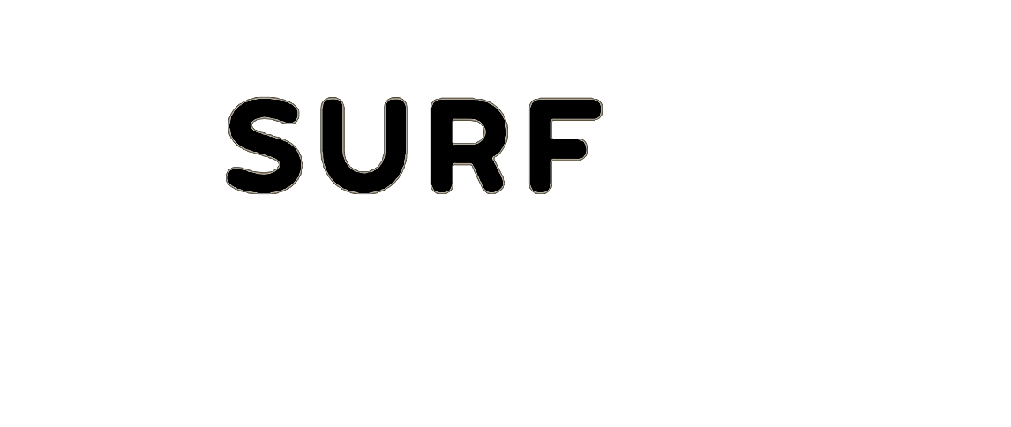
Prerequisites
Programming
R / Python
Statistics, Calculus
Machine Learning
Parallel Computing

Slide 3
Machine Learning
High Performance Machine Learning Group

Slide 4
What ML is not:
Mimicking human intelligence
Robotics
Deep Learning
Notes:
Let's clear up some misconceptions

Slide 5
What ML is not:
Mimicking human intelligence
Robotics
Deep Learning
“
ML is the study of algorithms that can improve through experience and by the use of data. It is seen as part of Artificial Intelligence
~ Wikipedia

Slide 6
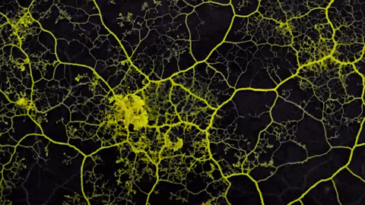
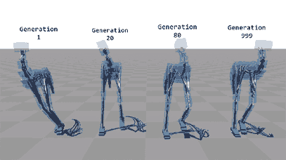
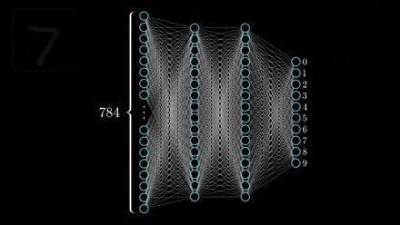
Artificial Intelligence
Having computers exert
Intelligent behaviour
Notes:
intelligent but not neccessarily human

Slide 7
Artificial Intelligence
Machine Learning
Having computers exert
Intelligent behaviour
Perform tasks not
Explicitly programmed, but learnt
from data

Slide 8
Artificial Intelligence
Machine Learning
Deep Learning
Having computers exert
Intelligent behaviour
Perform tasks not
Explicitly programmed, but learnt
from data
Use deep neural networks
Notes:
intelligent, but not necessarily human

Slide 9
Why Machine Learning?
Think of a simple decision tree

Slide 10
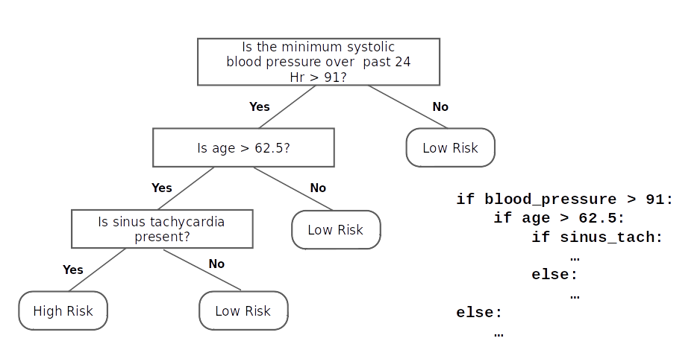
Why Machine Learning?
Think of a simple decision tree
Notes:
Simple, equates to a couple of if-else statements

Slide 11
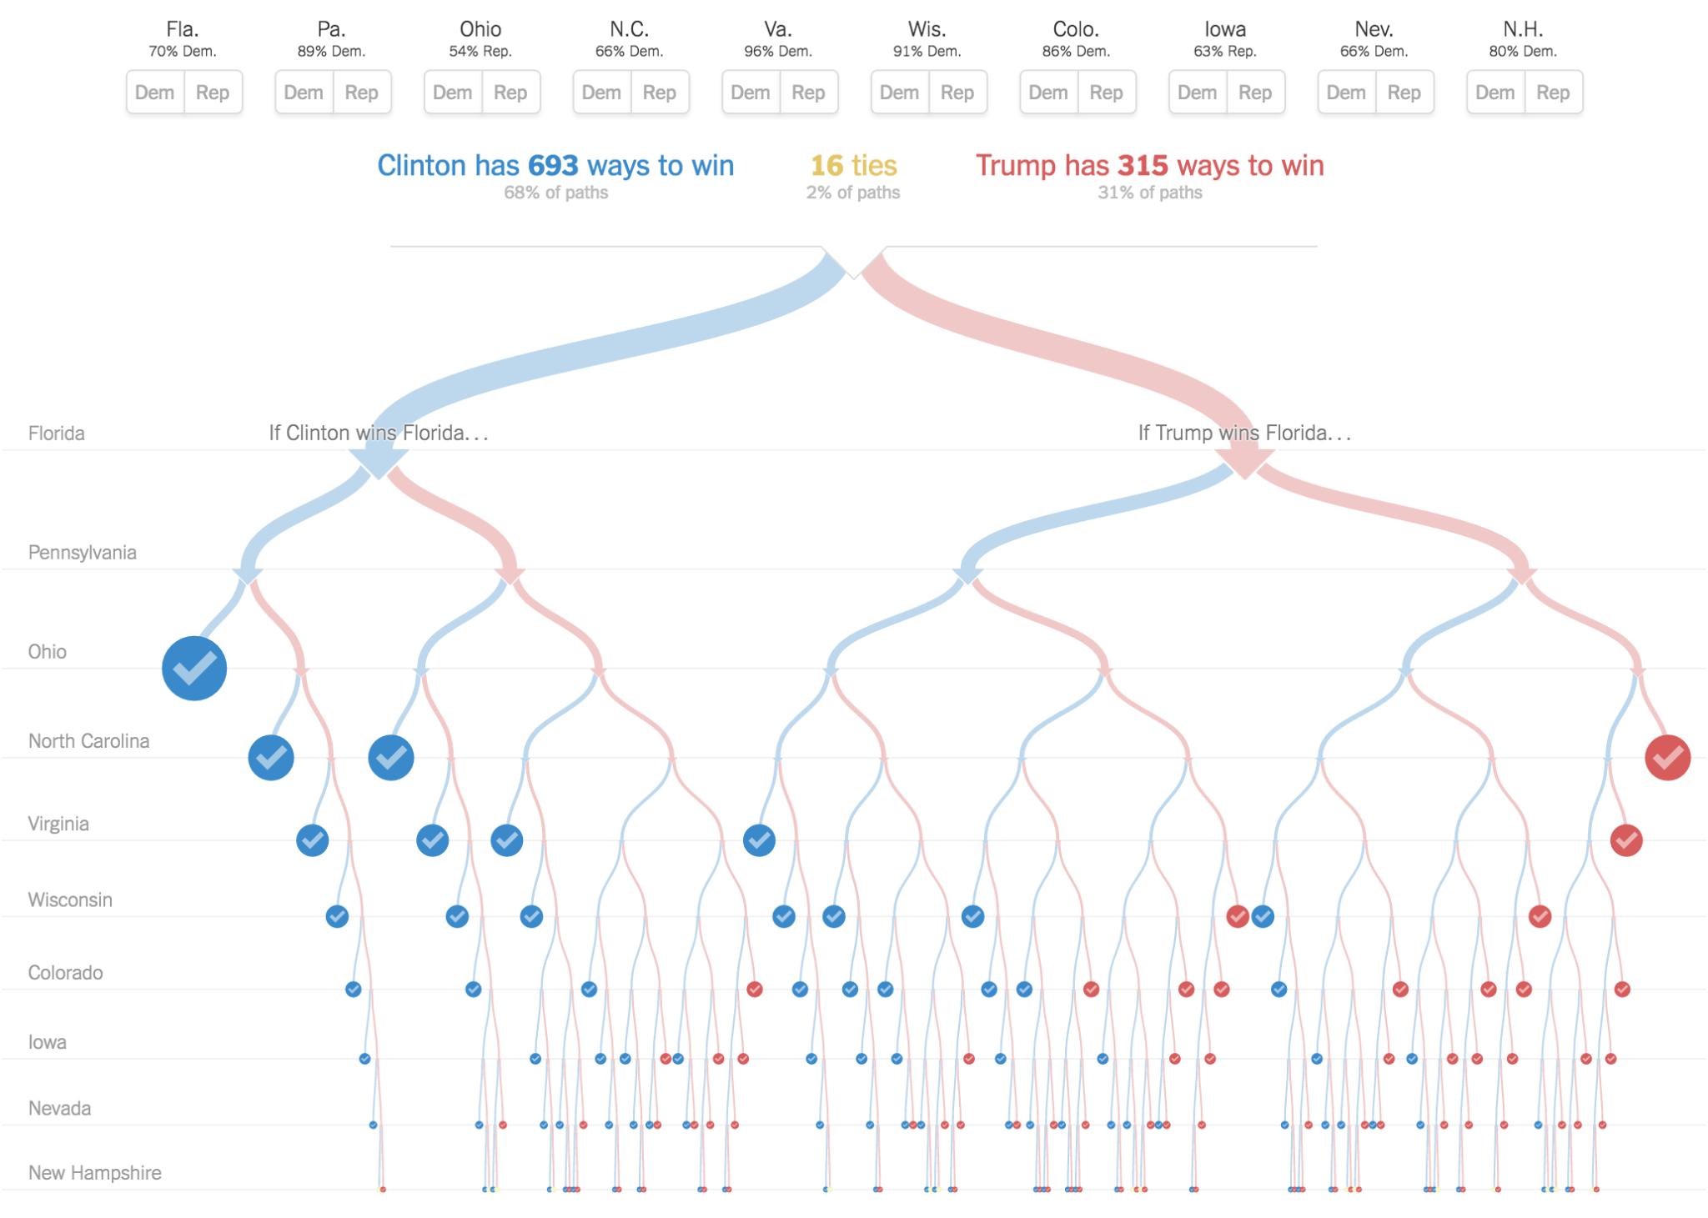
Why Machine Learning?
Think of a hard decision tree
Notes:
More complex, but still doable in if-else

Slide 12
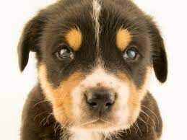
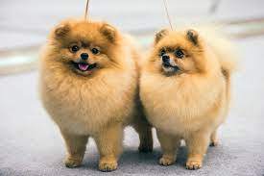

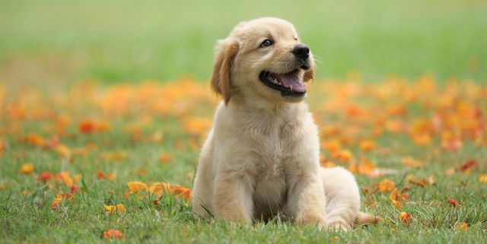

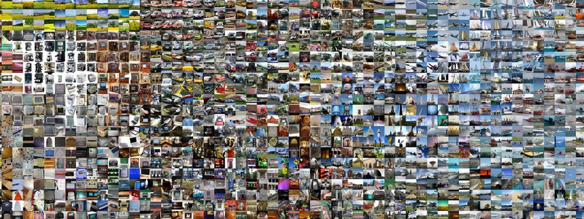
What is a dog?
Uncountable features that define a dog
We want an automatic way of learning these features
Driven by Data
Notes:
Consider the question: what is a dog? (determined from pictures)
No longer feasible

Slide 13
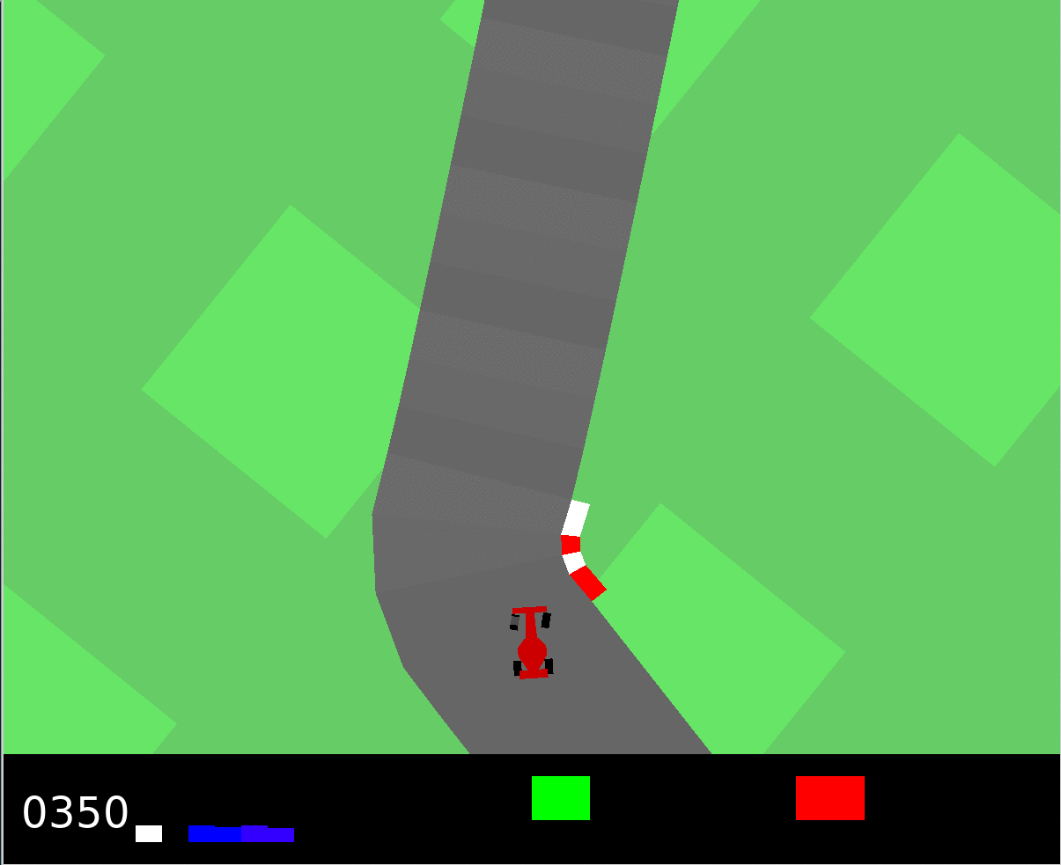
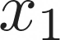
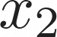
Categories of Machine Learning
01.
02.
03.
Supervised
Unsupervised
Reinforcement
Learn from labels
Regression, Classification
Detect Patterns in the data
Clustering, Dimensionality Reduction
Learn from the environment
Control, gaming
Notes:
reinforcement learning: reward based learning. Where in supervised learning the right answer is known, in reinforcement learning only a reward (e.g. money or pleasure) is known, but not known if better options exist

Slide 14
Neural Networks
High Performance Machine Learning Group

Slide 15
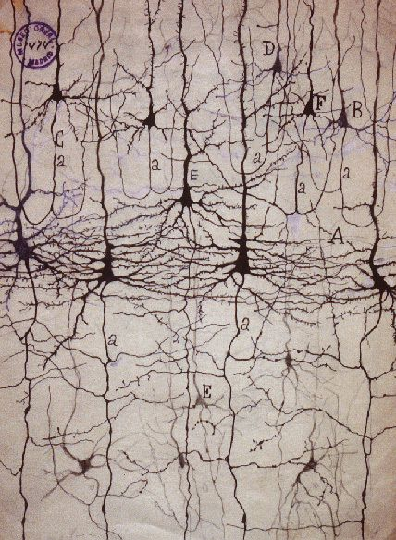
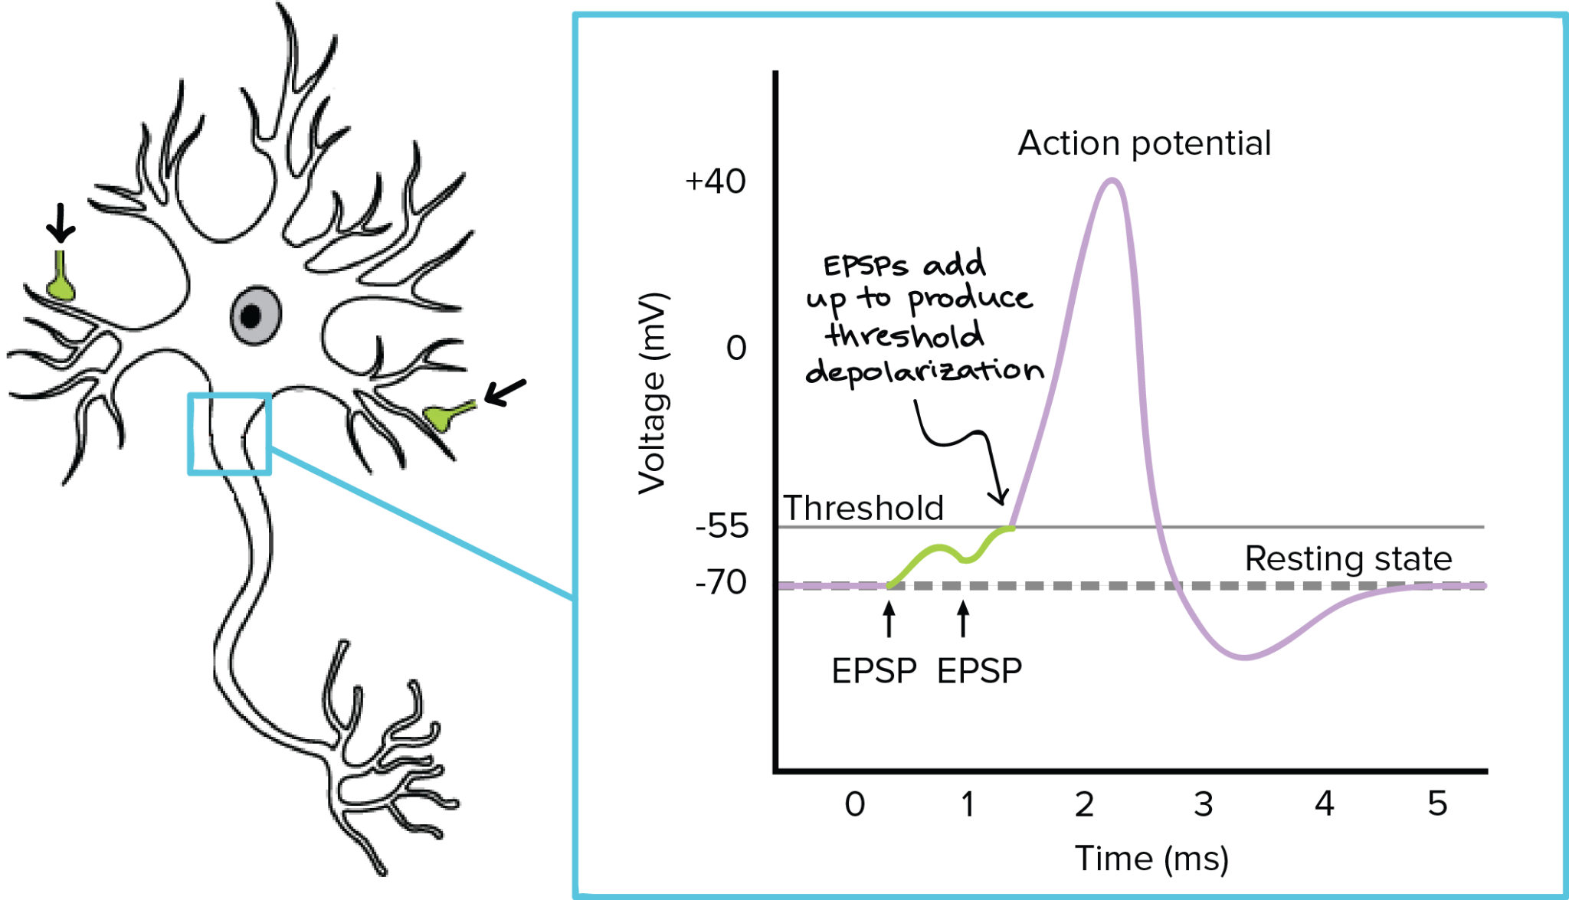
Biological Neuron
A neuron inhibits or excites a signal picked up from its receivers
Only fires if a threshold is reached and is connected to thousands of others.
Humans have around 80 billion neurons and trillions of connections
Notes:
Human brain is a 'network' of these types of neurons

Slide 16
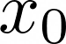
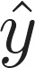
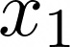
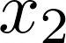
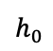
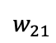
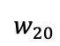
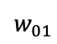
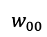
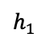
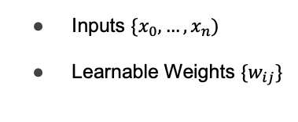
Anatomy of an Artificial Neural Network
Don’t model the biological neuron precisely
$$h_{0}$$
Inputs $\{x_{0},…,x_{n})$
Learnable Weights $\{w_{ij}\}$
$$w_{00}$$
$$w_{01}$$
$$w_{20}$$
$$w_{21}$$
$$h_{1}$$
Notes:
In ANNs we use inputs (data), bias, weights, dot product and non-linearity to....

Slide 17
Anatomy of an Artificial Neural Network
Don’t model the biological neuron precisely
Use a (deep) neural network to approximate an unknown function
$$h_{0}$$
Inputs $\{x_{0},…,x_{n})$
Learnable Weights $\{w_{ij}\}$
$$w_{00}$$
$$w_{01}$$
$$w_{20}$$
$$w_{21}$$
$$h_{1}$$
Notes:
approximate an unknown function

Slide 18
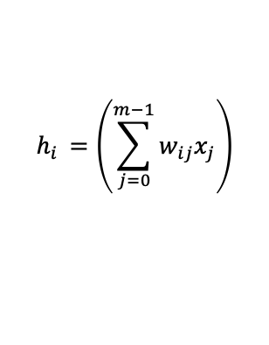
Anatomy of an Artificial Neural Network
Don’t model the biological neuron precisely
Use a (deep) neural network to approximate an unknown function
$$h_{0}$$
Inputs $\{x_{0},…,x_{n})$
Learnable Weights $\{w_{ij}\}$
$$w_{00}$$
$$w_{01}$$
$$w_{20}$$
$$w_{21}$$
$$h_{1}$$
$$h_{i }=\left(\sum_{j=0}^{m−1}{w_{ij}x_{j}}\right)$$

Slide 19
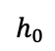
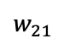
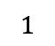
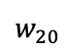
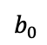
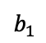
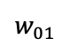
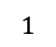
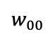
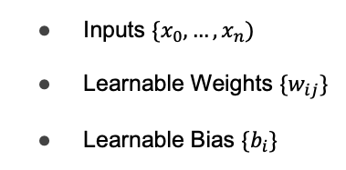
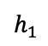
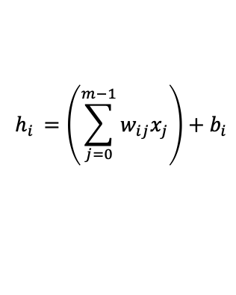
Anatomy of an Artificial Neural Network
Don’t model the biological neuron precisely
$$h_{0}$$
Use a (deep) neural network to approximate an unknown function
$$w_{00}$$
$$w_{01}$$
Inputs $\{x_{0},…,x_{n})$
Learnable Weights $\{w_{ij}\}$
Learnable Bias ${\{b}_{i}\}$
$$w_{20}$$
$$w_{21}$$
$$h_{1}$$
$$b_{0}$$
$$b_{1}$$
$$1$$
$$1$$
$$h_{i }=\left(\sum_{j=0}^{m−1}{w_{ij}x_{j}}\right)+b_{i}$$

Slide 20
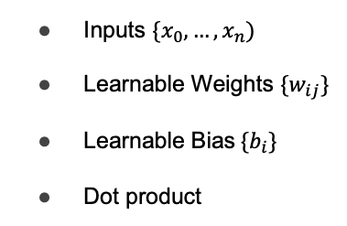
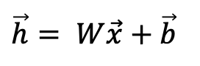
Anatomy of an Artificial Neural Network
Don’t model the biological neuron precisely
$$h_{0}$$
Use a (deep) neural network to approximate an unknown function
$$w_{00}$$
$$w_{01}$$
Inputs $\{x_{0},…,x_{n})$
Learnable Weights $\{w_{ij}\}$
Learnable Bias${\{b}_{i}\}$
Dot product
$$w_{20}$$
$$w_{21}$$
$$h_{1}$$
$$b_{0}$$
$$b_{1}$$
$$1$$
$$1$$
$$h_{i }=\left(\sum_{j=0}^{m−1}{w_{ij}x_{j}}\right)+b_{i}$$
$$\vec{h}= W\vec{x}+\vec{b}$$
Notes:
Can be written as a matrix-vector multiplication

Slide 21
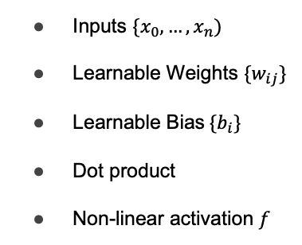
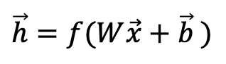
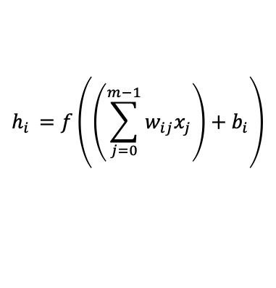
Anatomy of an Artificial Neural Network
Don’t model the biological neuron precisely
$$h_{0}$$
Use a (deep) neural network to approximate an unknown function
$$w_{00}$$
$$w_{01}$$
Inputs $\{x_{0},…,x_{n})$
Learnable Weights $\{w_{ij}\}$
Learnable Bias${ \{b}_{i}\}$
Dot product
Non-linear activation $f$
$$w_{20}$$
$$w_{21}$$
$$h_{1}$$
$$b_{0}$$
$$b_{1}$$
$$1$$
$$1$$
$$h_{i }=f\left(\left(\sum_{j=0}^{m−1}{w_{ij}x_{j}}\right)+b_{i}\right)$$
$$\vec{h}=f(W\vec{x}+\vec{b} )$$
Notes:
Can be written as a matrix-vector multiplication

Slide 22

Anatomy of an Artificial Neural Network
Don’t model the biological neuron precisely
$$h_{0}$$
Use a (deep) neural network to approximate an unknown function
$$w_{00}$$
$$w_{01}$$
Inputs $\{x_{0},…,x_{n})$
Learnable Weights $\{w_{ij}\}$
Learnable Bias ${\{b}_{i}\}$
Dot product
Non-linear activation $f$
$$w_{20}$$
$$w_{21}$$
$$h_{1}$$
$$b_{0}$$
$$b_{1}$$
$$1$$
$$1$$
Easy to compose and easy to vectorize
Fits current compute paradigm
$$h_{i }=f\left(\left(\sum_{j=0}^{m−1}{w_{ij}x_{j}}\right)+b_{i}\right)$$
$$\vec{h}=f(W\vec{x}+\vec{b} )$$
Notes:
In learning, we learn the weights W and bias b

Slide 23
The Perceptron and Activation
Binary Classification Task
0
Notes:
Let's consider

Slide 24
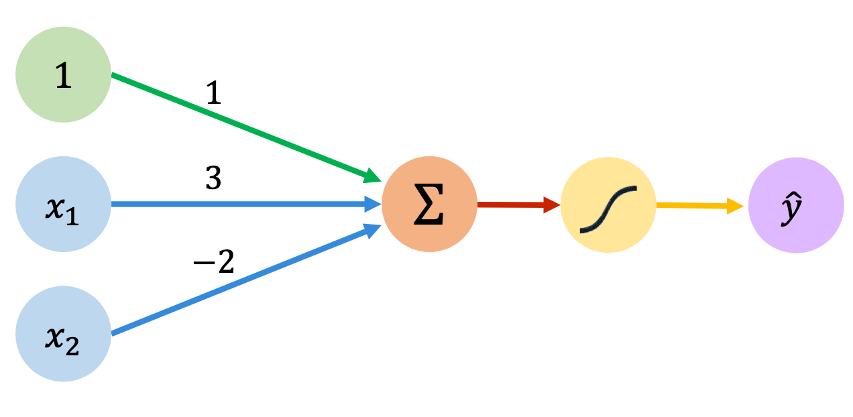
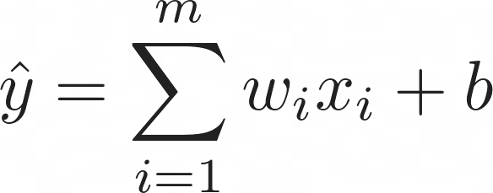
The Perceptron and Activation
Binary Classification Task
0

Slide 25
The Perceptron and Activation
Binary Classification Task
0
Notes:
With random init

Slide 26
The Perceptron and Activation
Binary Classification Task
0
Notes:
and as we learn...

Slide 27
The Perceptron and Activation
Binary Classification Task
0

Slide 28
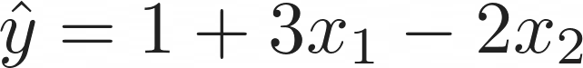
The Perceptron and Activation
Binary Classification Task
0
Notes:
we learn the following decision boundary. If y hat is 0 we are on the boundary

Slide 29
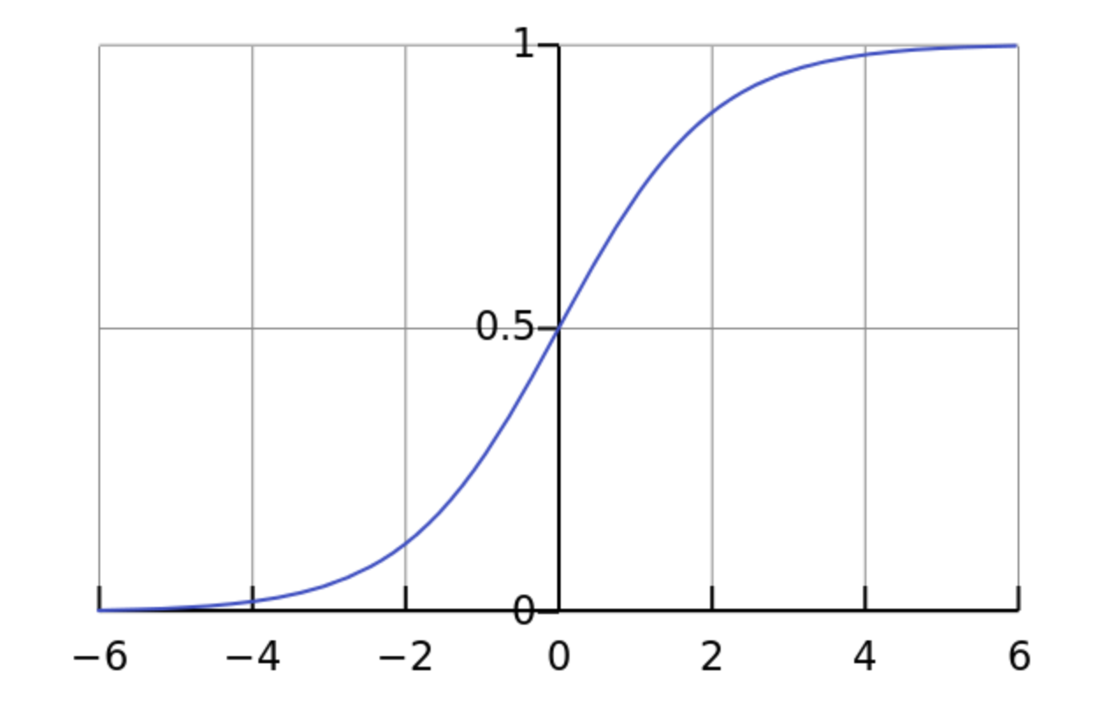
The Perceptron and Activation
Binary Classification Task
Sigmoid
0
Notes:
Then we use a non-linearity sigmoid that squashes y hat between 0 and 1 (0 maps to 0.5), where between 1 and 0.5 is red and otherwise green.

Slide 30
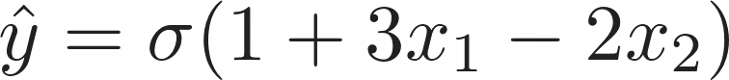
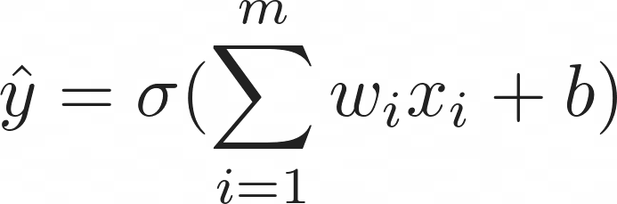
The Perceptron and Activation
Binary Classification Task
Sigmoid
0
Notes:
Leading to the final equation

Slide 31

Limitations of Linear Single Layer Classifiers

Slide 32
Limitations of Linear Single Layer Classifiers
Possible Solutions
Add more layers (deep learning)
Map into another (higher dimensional) space
We need to be able to automatically extract features

Slide 33

Limitations of Linear Single Layer Classifiers

Slide 34
Universal Approximation Theorem
“
A neural network with a single hidden layer of sufficient size
Can approximate any continuous function

Slide 35
Universal Approximation Theorem
There exists a true function relating the inputs to the outputs
A neural network can approximate this function to arbitrary precision given sufficient layer size
The required layer size can be extremely large and grow rapidly with the dimensionality of the problem
“
A neural network with a single hidden layer of sufficient size
Can approximate any continuous function

Slide 36
Universal Approximation Theorem
There exists a true function relating the inputs to the outputs
A neural network can approximate this function to arbitrary precision given sufficient layer size
The required layer size can be extremely large and grow rapidly with the dimensionality of the problem
“
A neural network with a single hidden layer of sufficient size
Can approximate any continuous function
Use of multiple hidden layers makes the NN vector representation of your problem increasingly more abstract
How do we train?
Compute grows (almost) exponentially

Slide 37

Predicting Housing Price
During the optimization process
The NN learns to encode a representation that maps
the input to the output
Notes:
Consider the prediction of house prices

Slide 38
Predicting Housing Price
# beds
During the optimization process
The NN learns to encode a representation that maps
the input to the output
Size
Zip-Code
Wealth

Slide 39
Predicting Housing Price
# beds
?
During the optimization process
The NN learns to encode a representation that maps
the input to the output
Size
?
Zip-Code
?
Wealth
Notes:
but what are these features?

Slide 40
Predicting Housing Price
# beds
Family size
During the optimization process
The NN learns to encode a representation that maps
the input to the output
Size
?
Zip-Code
Wealth
School Quality
Notes:
They are more complex features, such as...
but ultimately, we cannot interpret these, especially in larger models.

Slide 41


Predicting Faces
During the optimization process
The NN learns to encode a representation that maps
the input to the output
A deep neural network encodes the representation in an increasingly abstract way
Notes:
On images we can visualise what the model is doing

Slide 42


Activation Functions
One of the reasons that enable NNs to encode highly abstract features is the use of non-linear activation functions.
Not using non-linearities leads to linear networks since
$${W_{2}(W}_{1}x)=\hat{W}x$$
where $\hat{W}=W_{2}W_{1}$
Notes:
Not using non-linear results in effective single layer

Slide 43
Activation Functions
One of the reasons that enable NNs to encode highly abstract features is the use of non-linear activation functions.
Not using non-linearities leads to linear networks since
$${W_{2}(W}_{1}x)=\hat{W}x$$
where $\hat{W}=W_{2}W_{1}$
Probability Estimate
Continuously differentiable
Vanishing derivatives due to saturated neurons
Relatively expensive
Notes:
differentiable is important for NNs
vanishing derivatives -> derivative becomes too small after multiple layers

Slide 44
Activation Functions
One of the reasons that enable NNs to encode highly abstract features is the use of non-linear activation functions.
Not using non-linearities leads to linear networks since
$${W_{2}(W}_{1}x)=\hat{W}x$$
where $\hat{W}=W_{2}W_{1}$
Probability Estimate
Continuously differentiable
Vanishing derivatives due to saturated neurons
Relatively expensive

Slide 45
Activation Functions
One of the reasons that enable NNs to encode highly abstract features is the use of non-linear activation functions.
Not using non-linearities leads to linear networks since
$${W_{2}(W}_{1}x)=\hat{W}x$$
where $\hat{W}=W_{2}W_{1}$
Probability Estimate
Continuously differentiable
Vanishing derivatives due to saturated neurons
Relatively expensive
Very cheap to compute
Piece-wise linear functions
Dead neurons
Not differentiable at 0

Slide 46
Activation Functions
One of the reasons that enable NNs to encode highly abstract features is the use of non-linear activation functions.
Not using non-linearities leads to linear networks since
$${W_{2}(W}_{1}x)=\hat{W}x$$
where $\hat{W}=W_{2}W_{1}$
Probability Estimate
Continuously differentiable
Vanishing derivatives due to saturated neurons
Relatively expensive
Very cheap to compute
Piece-wise linear functions
Dead neurons
Not differentiable at 0
Activation functions are applied to the output of each neuron (point-wise)
Simple derivative
Non-linear behaviour

Slide 47
Activation Functions
One of the reasons that enable NNs to encode highly abstract features is the use of non-linear activation functions.
Not using non-linearities leads to linear networks since
$${W_{2}(W}_{1}x)=\hat{W}x$$
where $\hat{W}=W_{2}W_{1}$
Probability Estimate
Continuously differentiable
Vanishing derivatives due to saturated neurons
Relatively expensive
Very cheap to compute
Piece-wise linear functions
Dead neurons
Not differentiable at 0
Activation functions are applied to the output of each neuron (point-wise)
Simple derivative
Non-linear behaviour
ReLU made our lives much easier and faster
Most commonly used activation

Slide 48
Activation Functions
One of the reasons that enable NNs to encode highly abstract features is the use of non-linear activation functions.
Not using non-linearities leads to linear networks since
$${W_{2}(W}_{1}x)=\hat{W}x$$
where $\hat{W}=W_{2}W_{1}$
Probability Estimate
Continuously differentiable
Vanishing derivatives due to saturated neurons
Relatively expensive
Very cheap to compute
Piece-wise linear functions
Dead neurons
Not differentiable at 0
Activation functions are applied to the output of each neuron (point-wise)
Simple derivative
Non-linear behaviour
ReLU made our lives much easier and faster
Most commonly used activation
Many more! We can design our own!

Slide 49


Activation Functions
Many more! We can design our own!
Notes:
Some more examples, along with the effect they have on training.

Slide 50

Neural Network Demo
https://playground.tensorflow.org/

Slide 51
Neural Network
The output of previous layer is used as an input to the next layer
The input layer is data input and the output is a prediction
Anything in between is hidden
Layers are represented as vectors
Edges are weight matrices
We train the weights
Notes:
Quick recap
we train weights (and biases)

Slide 52
Neural Network Training
High Performance Machine Learning Group
Notes:
How does training work?

Slide 53
Recipe for Training
01.
02.
03.
04.
What function to optimize?
Define the function to approximate
your desired solution (loss function)
How to evaluate the model?
Which metrics are going to tell us how well we are doing on unseen data?
Process your data
Define the data to be used
Do we have labels?
Define the Model
Define the layers and
The forward propagation

Slide 54

Recipe for Training
01.

Slide 55
Recipe for Training
01.
02.

Slide 56

Recipe for Training
01.
02.
03.
MSE

Slide 57

Recipe for Training
01.
02.
03.
MSE
CE

Slide 58
Recipe for Training
01.
02.
03.
04.
MSE
CE
Accuracy, F1-score, precision, recall

Slide 59

Loss Functions
The loss function is used to bridge the gap between
your neural network predictions and the true value
We optimize (minimize) the loss to tune the weights
In the direction of biggest positive change
The function should be smooth and differentiable.
Notes:
Let's take a look at loss functions

Slide 60
Loss Functions
The loss function is used to bridge the gap between
your neural network predictions and the true value
We optimize (minimize) the loss to tune the weights
In the direction of biggest positive change
The function should be smooth and differentiable.
Distance/statistical metric assumes a Gaussian prior
Easy to understand, easy to
Compute
Prone to outliers
Not suitable for classification
problems
Notes:
outlier -> if one sample in data is very different the model focusses heavily on that due to the squaring

Slide 61

Loss Functions
The loss function is used to bridge the gap between
your neural network predictions and the true value
We optimize (minimize) the loss to tune the weights
In the direction of biggest positive change
The function should be smooth and differentiable.
Distance/statistical metric assumes a Gaussian prior
Easy to understand, easy to
Compute
Prone to outliers
Not suitable for classification
problems
Suitable for multi-class
problems
Information theory foundation
Not exactly the most stable loss
Notes:
Cross entropy

Slide 62
Loss Functions
The loss function is used to bridge the gap between
your neural network predictions and the true value
We optimize (minimize) the loss to tune the weights
In the direction of biggest positive change
The function should be smooth and differentiable.
CE is the negative
log-likelihood
Most commonly used activation for
classification
Distance/statistical metric assumes a Gaussian prior
Easy to understand, easy to
Compute
Prone to outliers
Not suitable for classification
problems
Suitable for multi-class
problems
Information theory foundation
Not exactly the most stable loss

Slide 63
Loss Functions
The loss function is used to bridge the gap between
your neural network predictions and the true value
We optimize (minimize) the loss to tune the weights
In the direction of biggest positive change
The function should be smooth and differentiable.
CE is the negative
log-likelihood
Most commonly used activation for
classification
Distance/statistical metric assumes a Gaussian prior
Easy to understand, easy to
Compute
Prone to outliers
Not suitable for classification
problems
Suitable for multi-class
problems
Information theory foundation
Not exactly the most stable loss
Many more! We can design our own!

Slide 64

Stochastic Gradient Descent
01.
Notes:
How do we minimize the loss? Using SGD
Let's consider a model with params w_a and w_b, with loss function L. Point to loss landscape

Slide 65
Stochastic Gradient Descent
01.
Computing the minimum is not possible for a large number of weights/a lot of data.
But given a (random) initialization of the weights, we can compute the gradient.

Slide 66

Stochastic Gradient Descent
01.
02.

Slide 67
Stochastic Gradient Descent
01.
02.
Create batches of N examples to propagate
and compute
03.

Slide 68
Stochastic Gradient Descent
01.
02.
Create batches of N examples to propagate
and compute
03.
04.
Notes:
Then we update the weights as follows:

Slide 69
Stochastic Gradient Descent
01.
02.
Create batches of N examples to propagate
and compute
03.
04.
Learning Rate
Choice of learning rate critical
SGD is the main engine behind training
Many variations exist
Notes:
where alpha is learning rate.
We then repeat this many times, resulting in animation on the left

Slide 70
Stochastic Gradient Descent
01.
02.
Create batches of N examples to propagate
and compute
03.
04.
Learning Rate
Choice of learning rate critical
SGD is the main engine behind training
Many variations exist
Relatively computationally efficient updates
No guarantee that we find the global optimum

Slide 71

Why it’s called stochastic gradient descent
Cost
w₁
w₁
w₀
w₀
We compute a stochastic estimator of the true gradient
On average points (batch) in the direction of the true gradient
Why?
Faster / less memory to compute gradient on small batch
Less likely to get stuck in a local minimum
Notes:
loss landscape is slightly different for each batch, potentially pushing us out of local minima

Slide 72



Backpropagation
A (deep) neural network is a deeply nested function:
We need to compute the gradient for each layer
Starting at the last layer, we apply the chain rule
This is backpropagation
…
…

Slide 73

Backpropagation
A (deep) neural network is a deeply nested function:
We need to compute the gradient for each layer
Starting at the last layer, we apply the chain rule
This is backpropagation
…
…
Notes:
.... so we compute gradient with respect to the output

Slide 74

Backpropagation
A (deep) neural network is a deeply nested function:
We need to compute the gradient for each layer
Starting at the last layer, we apply the chain rule
This is backpropagation
…
…
Notes:
use chain rule to propagate back to prev layer, giving us gradient w.r.t weights

Slide 75

Backpropagation
A (deep) neural network is a deeply nested function:
We need to compute the gradient for each layer
Starting at the last layer, we apply the chain rule
This is backpropagation
…
…
Notes:
etc..

Slide 76

Combatting Overfitting
Notes:
One of the problems is overfitting

Slide 77

Combatting Overfitting

Slide 78
Combatting Overfitting
The more weights we need to train, the more complex the model becomes and the sooner it starts to memorize/overfit, if we don’t have enough data

Slide 79

Combatting Overfitting

Slide 80

Combatting Overfitting

Slide 81

Combatting Overfitting
Dropout prior
Weight decay
Early stopping
Batch Normalization
Dropout
Notes:
weights decay -> slowly bring weights closer to 0

Slide 82
Combatting Overfitting
Dropout prior
Weight decay
Early stopping
Batch Normalization
Dropout
Models always need regularization, no matter how big

Slide 83


Optimizers
In what way should we change the weights?

Slide 84

Optimizers
In what way should we change the weights?
Notes:
SGD is an optimizer, but there are other options based on it
e.g. 2nd order derivative, momentum

Slide 85
ML Workflow
Artificial Intelligence still heavily relies on human intelligence to optimise the process
High Performance Machine Learning Group

Slide 86

Imbalanced Training set
Training on imbalanced datasets can result in strong biases towards the over-represented labels

Slide 87

Imbalanced Training set

Slide 88


Data normalization
A process to transform the input data in a well-behaved form.
Prevents exploding/vanishing gradients, improves convergence speed.

Slide 89

Open Datasets
Processed, balanced, well-behaved and labelled datasets
tensorflow.org/datasets
kaggle.com/datasets
topepo.github.io/caret/data-sets.html
github.com/awesomedata/awesome-public-datasets
Notes:
Finding datasets can be hard, but there are sources with ......

Slide 90

Dataset Splitting
70%
20%
10%
Notes:
For our models, we split our datasets

Slide 91

Workflow

Slide 92
DL Frameworks
Do not compute your own gradients
High Performance Machine Learning Group

Slide 93


How to train your NN
Define neurons and layers
Define loss function
Forward propagate and compute loss
Compute gradient
Propagate backward
Update weights

Slide 94
Notes:
In this course we focus on PyTorch

Slide 95

Three Levels of Abstraction
Tensor: imperative ndarray, possible to run on GPU/TPU
(node) Variable: Node in the built computational graph; data, gradient storage
(NN) Module: A neural network layer, store the state and the weights of the neural network

Slide 96
Three Levels of Abstraction
Tensor: imperative ndarray, possible to run on GPU/TPU
(node) Variable: Node in the built computational graph; data, gradient storage
(NN) Module: A neural network layer, store the state and the weights of the neural network

Slide 97
Three Levels of Abstraction
Tensor: imperative ndarray, possible to run on GPU/TPU
(node) Variable: Node in the built computational graph; data, gradient storage
(NN) Module: A neural network layer, store the state and the weights of the neural network

Slide 98
Three Levels of Abstraction
Tensor: imperative ndarray, possible to run on GPU/TPU
(node) Variable: Node in the built computational graph; data, gradient storage
(NN) Module: A neural network layer, store the state and the weights/gradients of the neural network

Slide 99

Three Levels of Abstraction
Tensor: imperative ndarray, possible to run on GPU/TPU
(node) Variable: Node in the built computational graph; data, gradient storage
(NN) Module: A neural network layer, store the state and the weights/gradients of the neural network

Slide 100

$$\hat{y}=g(W_{2}f\left(W_{1} \vec{x}+b_{1}\right)+b_{2})$$
Three Levels of Abstraction
Tensor: imperative ndarray, possible to run on GPU/TPU
(node) Variable: Node in the built computational graph; data, gradient storage
(NN) Module: A neural network layer, store the state and the weights/gradients of the neural network
X
dot
+
relu
dot
W_1
b_1
W_2
b_2

Slide 101
$$\hat{y}=g(W_{2}f\left(W_{1} \vec{x}+b_{1}\right)+b_{2})$$
Three Levels of Abstraction
Tensor: imperative ndarray, possible to run on GPU/TPU
(node) Variable: Node in the built computational graph; data, gradient storage
(NN) Module: A neural network layer, store the state and the weights/gradients of the neural network
X
dot
+
relu
dot
+
Exp
W_1
b_1
W_2
b_2
Sum
Div
log

Slide 102
$$\hat{y}=g(W_{2}f\left(W_{1} \vec{x}+b_{1}\right)+b_{2})$$
Three Levels of Abstraction
Tensor: imperative ndarray, possible to run on GPU/TPU
(node) Variable: Node in the built computational graph; data, gradient storage
(NN) Module: A neural network layer, store the state and the weights/gradients of the neural network
X
dot
+
relu
dot
+
Exp
W_1
b_1
W_2
b_2
Sum
Div
log
y
dot
neg

Slide 103
$$\hat{y}=g(W_{2}f\left(W_{1} \vec{x}+b_{1}\right)+b_{2})$$
Three Levels of Abstraction
Tensor: imperative ndarray, possible to run on GPU/TPU
(node) Variable: Node in the built computational graph; data, gradient storage
(NN) Module: A neural network layer, store the state and the weights/gradients of the neural network
X
dot
+
relu
dot
+
Exp
W_1
b_1
W_2
b_2
Sum
Div
log
y
dot
neg
PyTorch will helps us with
Defining a dataset
Automatic Gradient Computation
Defining Neural Networks
Optimization
Scheduling
Distributing

Slide 104

https://pytorch.org/docs/stable/
Notes:
PyTorch has extensive documentation, with many NN building blocks

Slide 105
General Training Structure
data loader
model
optimizer
loss function

Slide 106
General Training Structure
data loader
model
optimizer
loss function
For every datapoint, y in data_loader

Slide 107
General Training Structure
data loader
model
optimizer
loss function
For every datapoint, y in data_loader
optimizer.zero_grad()
Notes:
set gradients to zero

Slide 108
General Training Structure
data loader
model
optimizer
loss function
For every datapoint, y in data_loader
optimizer.zero_grad()
prediction = model(datapoint)

Slide 109
General Training Structure
data loader
model
optimizer
loss function
For every datapoint, y in data_loader
optimizer.zero_grad()
prediction = model(datapoint)
loss = loss_function(prediction, y)

Slide 110
General Training Structure
data loader
model
optimizer
loss function
For every datapoint, y in data_loader
optimizer.zero_grad()
prediction = model(datapoint)
loss = loss_function(prediction, y)
loss.backward()

Slide 111
General Training Structure
data loader
model
optimizer
loss function
For every datapoint, y in data_loader
optimizer.zero_grad()
prediction = model(datapoint)
loss = loss_function(prediction, y)
loss.backward()
optimizer.step()

Slide 112

General Training Structure
data loader
model
optimizer
loss function
For every datapoint, y in data_loader
optimizer.zero_grad()
prediction = model(datapoint)
loss = loss_function(prediction, y)
loss.backward()
optimizer.step()

Slide 113
Data:
d_1 = [0.9, -0.2], y = 0
d_2 = [0.75, 0.6],y = 1

Slide 114
Data:
d_1 = [0.9, -0.2], y = 0
d_2 = [0.75, 0.6],y = 1
Define Neural Network
Input size of 2
One hidden layer of 8 nodes
1 output node (binary)

Slide 115
Data:
d_1 = [0.9, -0.2], y = 0
d_2 = [0.75, 0.6],y = 1
Define Neural Network
Input size of 2
One hidden layer of 8 nodes
1 output node (binary)
Learning rate = 0.01
Optimizer = Stochastic Gradient Descent
Loss = Binary Cross Entropy

Slide 116
Data:
d_1 = [0.9, -0.2], y = 0
d_2 = [0.75, 0.6],y = 1
Define Neural Network
Input size of 2
One hidden layer of 8 nodes
1 output node (binary)
Learning rate = 0.01
Optimizer = Stochastic Gradient Descent
Loss = Binary Cross Entropy

Slide 117


Data:
d_1 = [0.9, -0.2], y = 0
d_2 = [0.75, 0.6],y = 1
Define Neural Network
Input size of 2
One hidden layer of 8 nodes
1 output node (binary)
Learning rate = 0.01
Optimizer = Stochastic Gradient Descent
Loss = Binary Cross Entropy

Slide 118
HPML Group 05/11/2024
Fin
Introduction Series
https://jupyter.snellius.surf.nl/jhssrf015
Simone van Bruggen
Lars Veefkind

